Slide 1
Physical and Link Layers Protocols- LoRaWAN
LoRaWAN
LoRaWAN is an example of an unlicensed-band Low-Power Wide-Area (LPWA) technology.
LPWA particularly well adapted for long-range and battery-powered endpoints.
* IoT Fundamentals: Networking Technologies, Protocols, and Use Cases for the Internet of Thing, Cisco press, 2017

Slide 2
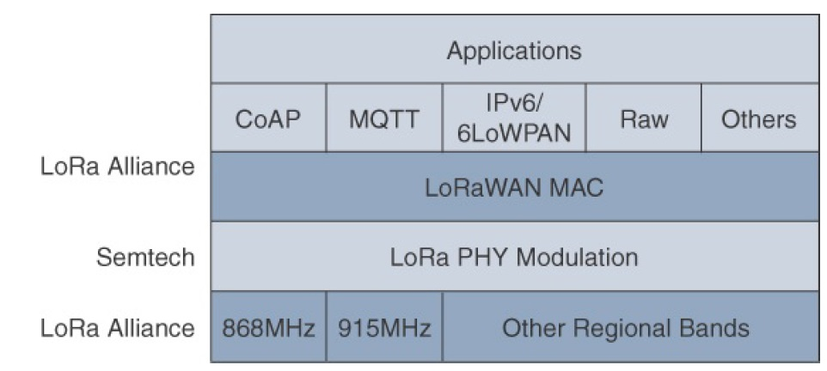
Physical and Link Layers Protocols- LoRaWAN
LoRaWAN Layers
Semtech is responsible for the PHY layer, while the LoRa Alliance handles the MAC layer and regional frequency bands
* IoT Fundamentals: Networking Technologies, Protocols, and Use Cases for the Internet of Thing, Cisco press, 2017
Notes:
Initially, LoRa was a physical layer, or Layer 1, modulation that was developed by a French company named Cycleo. Later, Cycleo was acquired by Semtech.
Optimized for long-range, two-way communications and low power consumption, the technology evolved from Layer 1 to a broader scope through the creation of the LoRa Alliance.
Semtech LoRa as a Layer 1 PHY modulation technology is available through multiple chipset vendors. To differentiate from the physical layer modulation known as LoRa, the LoRa Alliance uses the term LoRaWAN to refer to its architecture and its specifications that describe end-to-end LoRaWAN communications and protocols.
In this figure, notice that Semtech is responsible for the PHY layer, while the LoRa Alliance handles the MAC layer and regional frequency bands.
Overall, the LoRa Alliance owns and manages the roadmap and technical development of the LoRaWAN architecture and protocol. This alliance also handles the LoRaWAN endpoint certification program and technology promotion through its certification and marketing committees.

Slide 3
LoRaWAN-Standardization and Alliances
Initially, LoRa was a physical layer, or Layer 1, modulation that was developed by a French company named Cycleo. Later, Cycleo was acquired by Semtech (in 2012).
Semtech LoRa as a Layer 1 PHY modulation technology is available through multiple chipset vendors.
Semtech has licensed its LoRa intellectual property (ip) to other chip manufacturers, such as HopeRF, Microchip, Dorji, etc.
Optimized for long-range, two-way communications and low power consumption, the technology evolved from Layer 1 to a broader scope through the creation of the LoRa Alliance.
* IoT Fundamentals: Networking Technologies, Protocols, and Use Cases for the Internet of Thing, Cisco press, 2017
Notes:
Initially, LoRa was a physical layer, or Layer 1, modulation that was developed by a French company named Cycleo. Later, Cycleo was acquired by Semtech.
Optimized for long-range, two-way communications and low power consumption, the technology evolved from Layer 1 to a broader scope through the creation of the LoRa Alliance.
Semtech LoRa as a Layer 1 PHY modulation technology is available through multiple chipset vendors. To differentiate from the physical layer modulation known as LoRa, the LoRa Alliance uses the term LoRaWAN to refer to its architecture and its specifications that describe end-to-end LoRaWAN communications and protocols.
In this figure, notice that Semtech is responsible for the PHY layer, while the LoRa Alliance handles the MAC layer and regional frequency bands.
Overall, the LoRa Alliance owns and manages the roadmap and technical development of the LoRaWAN architecture and protocol. This alliance also handles the LoRaWAN endpoint certification program and technology promotion through its certification and marketing committees.

Slide 4
LoRaWAN-Standardization and Alliances
To differentiate from the physical layer modulation known as LoRa, the LoRa Alliance uses the term LoRaWAN to refer to its architecture and its specifications that describe end-to-end LoRaWAN communications and protocols.
* IoT Fundamentals: Networking Technologies, Protocols, and Use Cases for the Internet of Thing, Cisco press, 2017
Notes:
Initially, LoRa was a physical layer, or Layer 1, modulation that was developed by a French company named Cycleo. Later, Cycleo was acquired by Semtech.
Optimized for long-range, two-way communications and low power consumption, the technology evolved from Layer 1 to a broader scope through the creation of the LoRa Alliance.
Semtech LoRa as a Layer 1 PHY modulation technology is available through multiple chipset vendors. To differentiate from the physical layer modulation known as LoRa, the LoRa Alliance uses the term LoRaWAN to refer to its architecture and its specifications that describe end-to-end LoRaWAN communications and protocols.
In this figure, notice that Semtech is responsible for the PHY layer, while the LoRa Alliance handles the MAC layer and regional frequency bands.
Overall, the LoRa Alliance owns and manages the roadmap and technical development of the LoRaWAN architecture and protocol. This alliance also handles the LoRaWAN endpoint certification program and technology promotion through its certification and marketing committees.

Slide 5
LoRa Specification
The range between LoRa sender and receiver depends on the environment the equipment operates in. Indoor coverage largely depends on the type of building material used.
Environment | Range (km)
Urban areas (towns & cities) | 2-5
Rural areas (country sides) | 5-15
Direct Line of Sight | >15
Some notable records: Andreas Spiess, ground to ground connection: 212 km (= 131.73 miles) Weather balloon to ground connection: 702.67 km (= 436.61 miles)

Slide 6
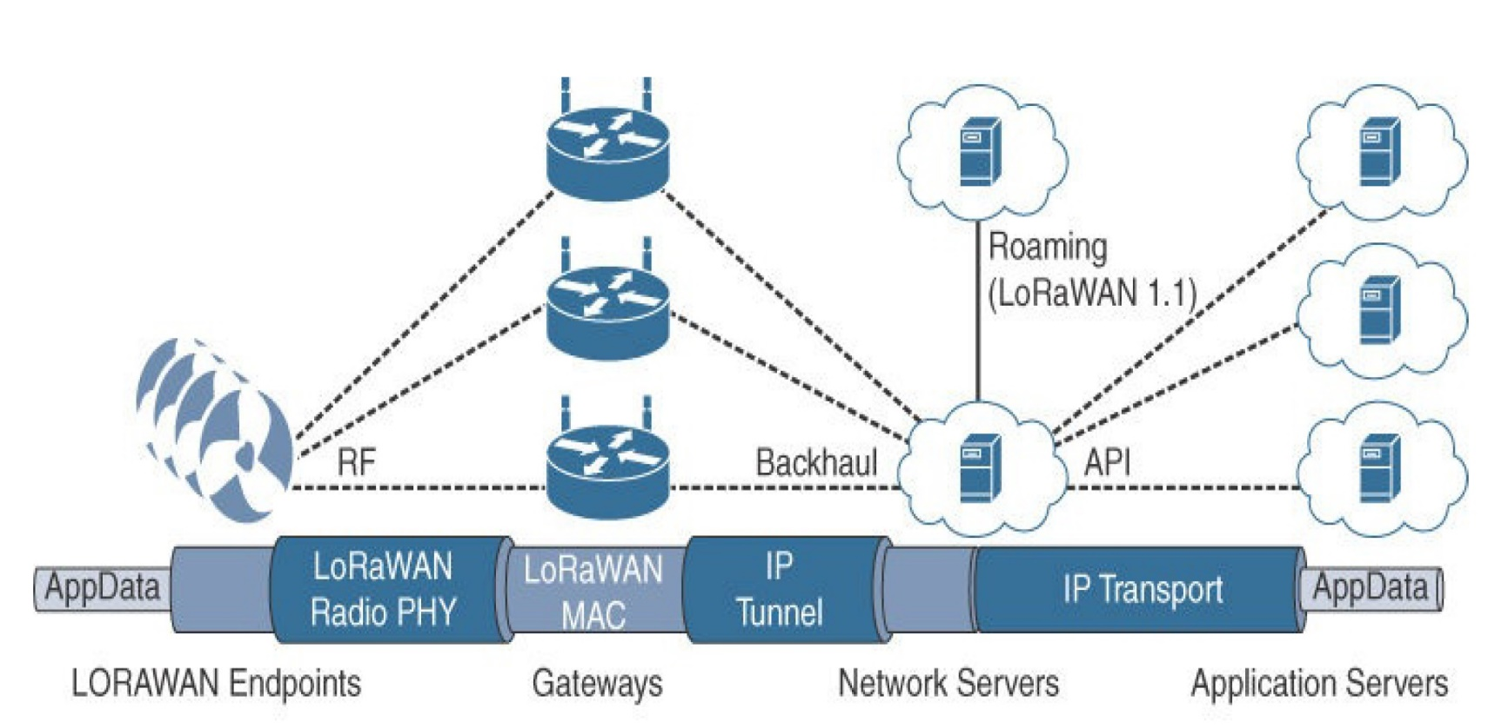
LoRaWAN- Topology
LoRaWAN
Topology
Star of stars
* IoT Fundamentals: Networking Technologies, Protocols, and Use Cases for the Internet of Thing, Cisco press, 2017
Notes:
LoRaWAN topology is often described as a “star of stars” topology. As shown in this figure, the infrastructure consists of endpoints exchanging packets through gateways acting as bridges, with a central LoRaWAN network server. Gateways connect to the backend network using standard IP connections, and endpoints communicate directly with one or more gateways.
LoRaWAN endpoints transport their selected application data over the LoRaWAN MAC layer on top of one of the supported PHY layer frequency bands. The application data is contained in upper protocol layers.
These upper layers are not the responsibility of the LoRa Alliance, but best practices may be developed and recommended. These upper layers could just be raw data on top of the LoRaWAN MAC layer, or the data could be stacked in multiple protocols. For example, you could have upper-layer protocols, such as ZigBee Control Layer (ZCL), Constrained Application Protocol (CoAP), or Message Queuing Telemetry Transport (MQTT), with or without an IPv6/6LoWPAN layer.
LoRaWAN gateways act as bridges that relay between endpoints and the network servers. Multiple gateways can receive and transport the same packets. When duplicate packets are received, deduplication is a function of the network server.

Slide 7
LoRaWAN- Topology
End-devices:
Perform the communication gateways using LoRa and LoRaWAN technologies.
Gateways (i.e., base stations):
Dispatch the LoRaWAN frames from the end devices to a network server using a back-haul interface with higher throughput, usually via Ethernet, 3G/4G, satellite or Wi-Fi.
The Network Server:
Decodes the packets sent by the devices, performing security checks and adaptive data rate, thus generating the control data that should be sent back to the devices.
Each Application:
Receives data from the network server. It should decode the security packets and uses the information to decide the action in the application.
Notes:
LoRaWAN topology is often described as a “star of stars” topology. As shown in this figure, the infrastructure consists of endpoints exchanging packets through gateways acting as bridges, with a central LoRaWAN network server. Gateways connect to the backend network using standard IP connections, and endpoints communicate directly with one or more gateways.
LoRaWAN endpoints transport their selected application data over the LoRaWAN MAC layer on top of one of the supported PHY layer frequency bands. The application data is contained in upper protocol layers.
These upper layers are not the responsibility of the LoRa Alliance, but best practices may be developed and recommended. These upper layers could just be raw data on top of the LoRaWAN MAC layer, or the data could be stacked in multiple protocols. For example, you could have upper-layer protocols, such as ZigBee Control Layer (ZCL), Constrained Application Protocol (CoAP), or Message Queuing Telemetry Transport (MQTT), with or without an IPv6/6LoWPAN layer.
LoRaWAN gateways act as bridges that relay between endpoints and the network servers. Multiple gateways can receive and transport the same packets. When duplicate packets are received, deduplication is a function of the network server.

Slide 8
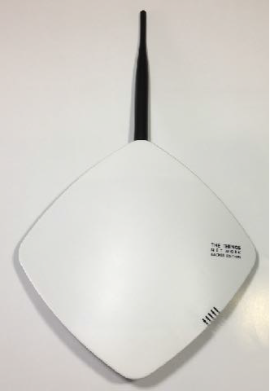
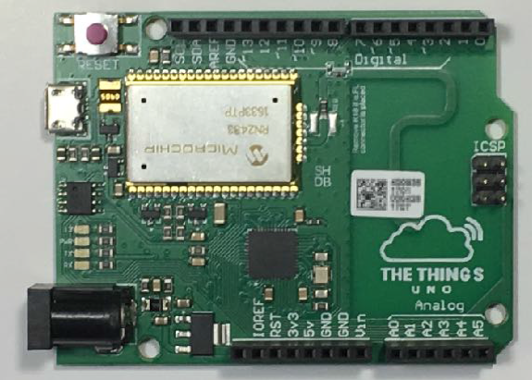
LoRaWAN- Topology
LoRa is an acronym for Long Range and it is a wireless technology where a low powered sender transmit small data packages (0.3 kbps to 5.5 kbps) to a receiver over a long distance.
A gateway can handle hundreds of devices at the same time.
The Things Gateway
(gateway / concentrator)
The Things Uno (end node)

Slide 9
LoRa End-Node
A LoRa end node consists of 2 parts:
A radio module with antenna.
A microprocessor to process for example the sensor data.
End nodes are often battery powered.
A LoRa device (end node) has a wireless transceiver. If this device also has sensors, this device acts as a remote sensor. Such a device is called a mote, short for remote.
printed antenna
radio module
microprocessor

Slide 10
LoRa Gateway
• A LoRa gateway consists of 2 parts:
• A radio module with antenna.
• A microprocessor to process the data.
• Gateways are mains powered and connected to the Internet.
• Multiple gateways can receive data from the same end node.
• The gateways can listen to multiple frequencies simultaneously

Slide 11
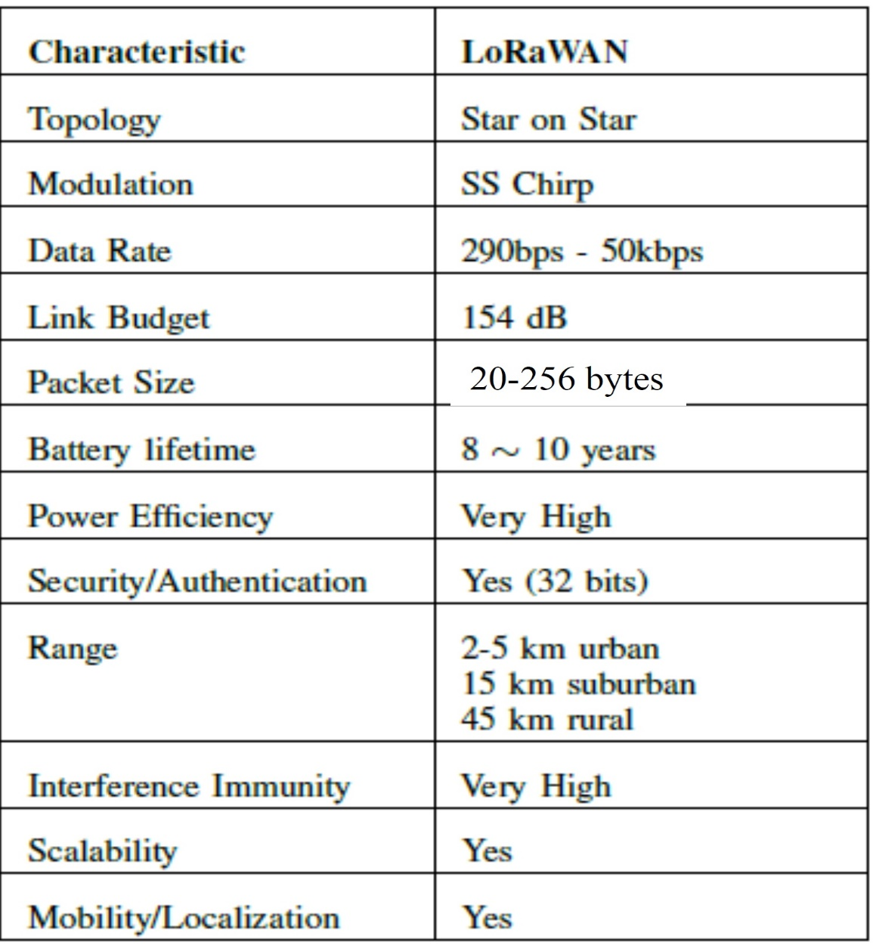
LoRaWAN: Specification
The most critical factors in a LPWAN are:
Network architecture;
Communication range;
Battery lifetime (low power);
Robustness to interference;
Network capacity (maximum number of nodes in a network);
Network security;
One-way vs two-way communication;
LoRaWAN - A Low Power WAN Protocol for Internet of Things: a Review and Opportunities, Inatel, 2017

Slide 12
LoRaWAN- How It Works?
End Node
broadcast its data to every gateway in its vicinity.
Gateways:
Forward this packet to the network server. It is only a protocol convertor.
Network Server:
Collects the messages from all gateways and filters out the duplicate data and determines the gateway that has the best reception.
Forwards the packet to the correct application server where the end user can process the sensor data.
Optionally the application server can send a response back to the end node.
When a response is sent, the network server receives the response and determines which gateway to use to broadcast the response back to the end node.

Slide 13
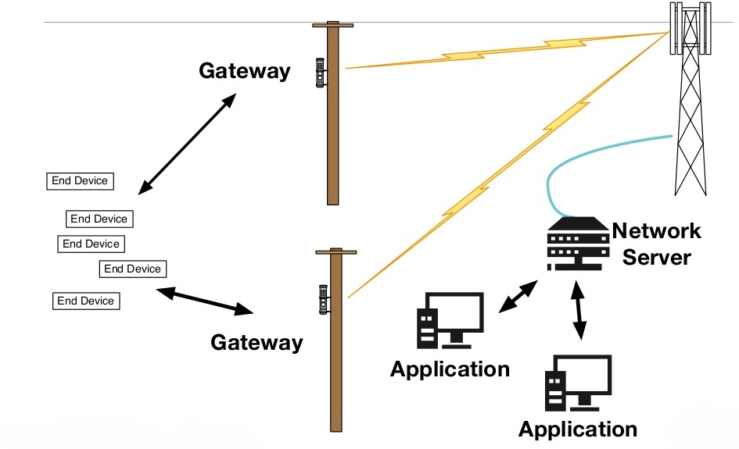
LoRaWAN- Topology

Slide 14
LoRaWAN- Topology
LoRaWAN network architecture is deployed in a star topology.
End nodes are not associated with a particular gateway. Rather, when a node sends data, it is typically received by multiple gateways.
Each of these gateways, in turn, forwards the received data toward the cloud-based network server using some backhaul technology.
The network server is responsible for all complex and intelligent functions:
it manages the network, filters redundant received data, performs security verification, schedules acknowledgments through the most optimal gateway, and performs adaptive rate control, etc.
A key feature of this architecture is that no handover mechanism is required from one gateway to another to support the mobility of end nodes.
Therefore, it is straightforward to enable IoT asset tracking applications.
Another key feature is the built-in access redundancy, where the failure of a gateway or path toward the network server is handled by sending redundant copies of data packets

Slide 15
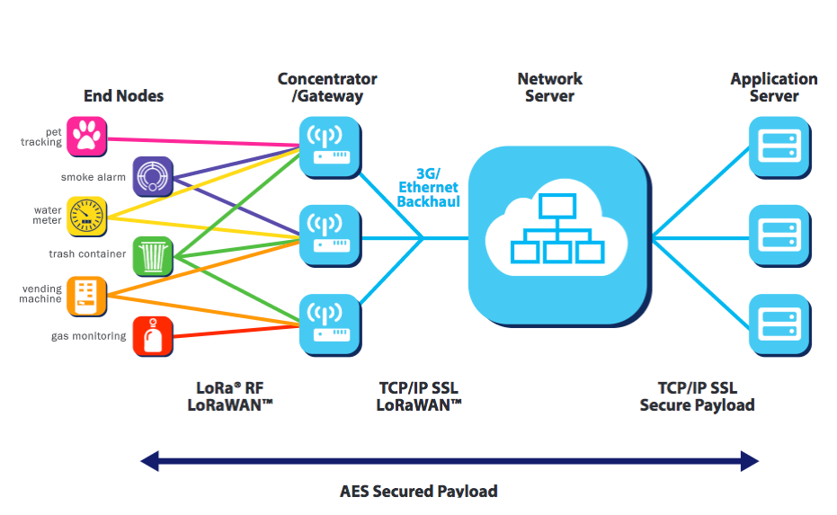
LoRaWAN- Topology
• LoRaWAN network architecture is deployed in a star topology.
The communication between the end node and gateway is bidirectional which means the end node can send data to the gateway but it can also receive data from the gateway.

Slide 16
LoRaWAN- Topology
LoRaWAN- LoRa gateway
A LoRa gateway is deployed as the center hub of a star network architecture.
It uses multiple transceivers and channels and can demodulate multiple channels at once or even demodulate multiple signals on the same channel simultaneously.
LoRa gateways serve as a transparent bridge relaying data between endpoints, and the endpoints use a single-hop wireless connection to communicate with one or many gateways.
* IoT Fundamentals: Networking Technologies, Protocols, and Use Cases for the Internet of Thing, Cisco press, 2017
Notes:
Physical Layer
Understanding LoRa gateways is critical to understanding a LoRaWAN system. A LoRa gateway is deployed as the center hub of a star network architecture. It uses multiple transceivers and channels and can demodulate multiple channels at once or even demodulate multiple signals on the same channel simultaneously. LoRa gateways serve as a transparent bridge relaying data between endpoints, and the endpoints use a single-hop wireless connection to communicate with one or many gateways.

Slide 17
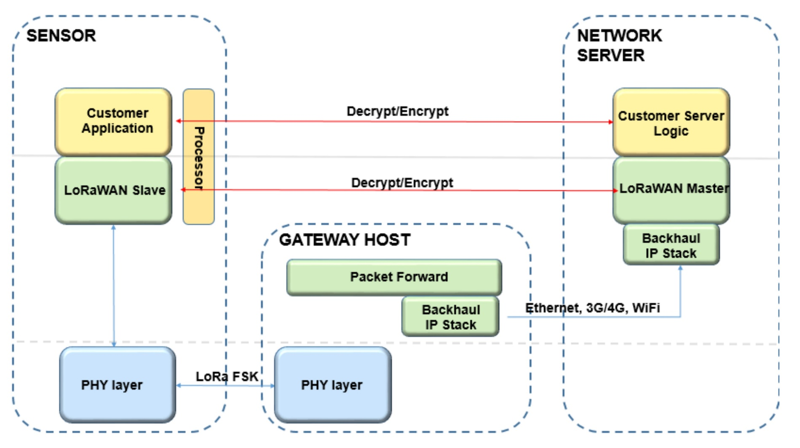
LoRaWAN Protocol
LoRaWAN - A Low Power WAN Protocol for Internet of Things: a Review and Opportunities, Inatel, 2017

Slide 18
Few Use Cases Using LoRa Technology
• Smart utilities
Power transformer monitoring
Water level monitoring
Utility meter
Fuel monitoring (monitoring fuel levels in fuel tanks for heating houses)
•Health & Hygiene
Temperature / humidity monitoring
Environmental monitoring
Waste management (monitoring waste level in waste bins)

Slide 19
Few Use Cases Using LoRa Technology
• Safety
Smart lightning
Water level monitoring
Radioactivity level monitoring
Dike monitoring (prevent peat dikes from drying out)
• Efficiency
Asset management (e.g. tracking containers, pallets, etc.)
Fleet management (e.g. tracking cars, vans, trucks, etc.)
• Agriculture
Monitoring animal welfare
Monitoring plant growing conditions

Slide 20
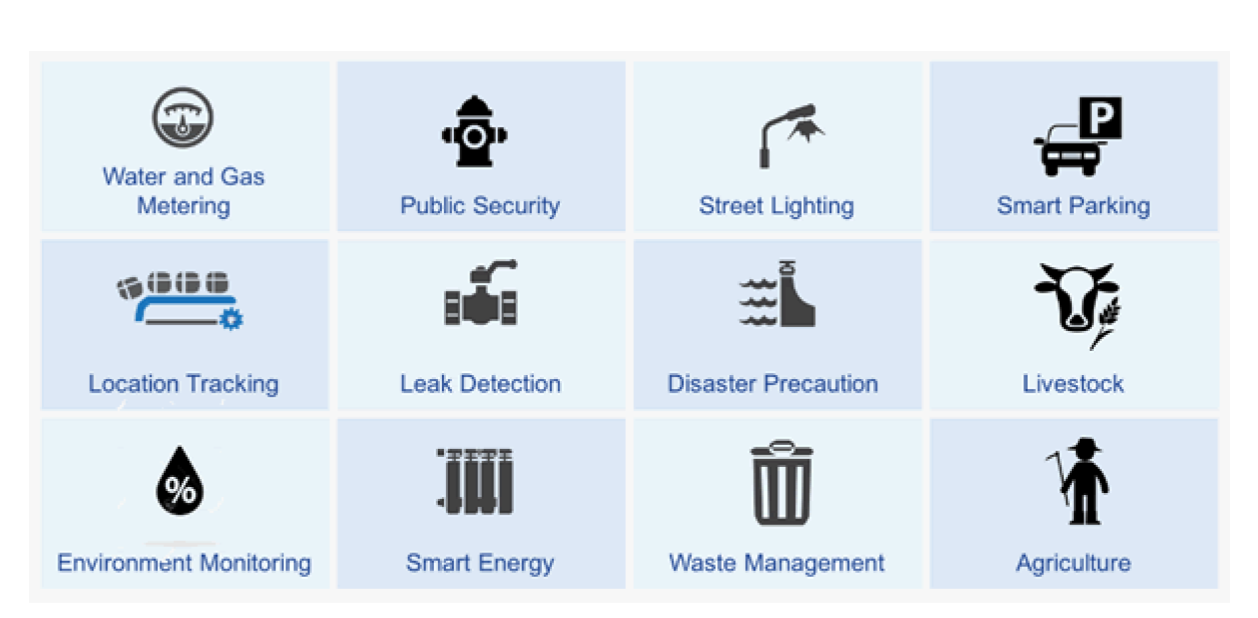
Few Use Cases Using LoRa Technology

Slide 21
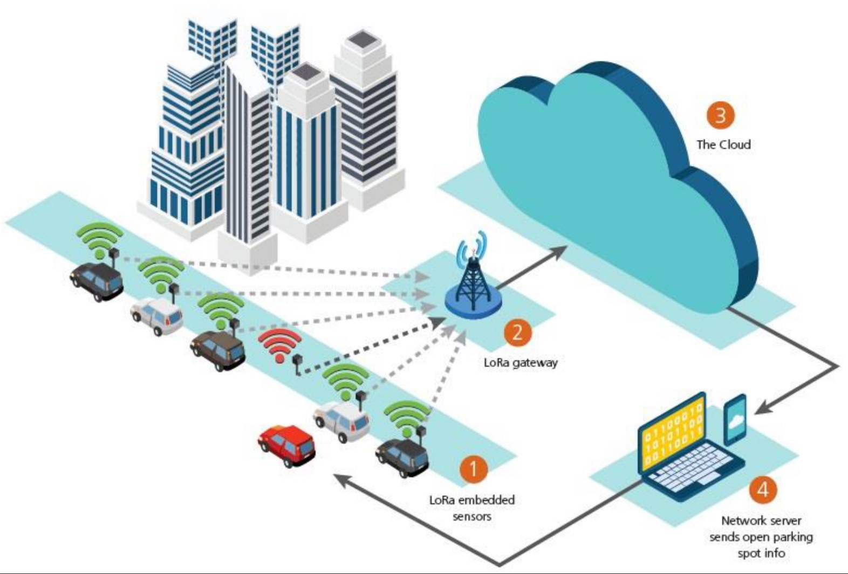
LoRaWAN Use Case- Parking Occupancy
IOT and LORAWAN, Quaenet, 2018

Slide 22
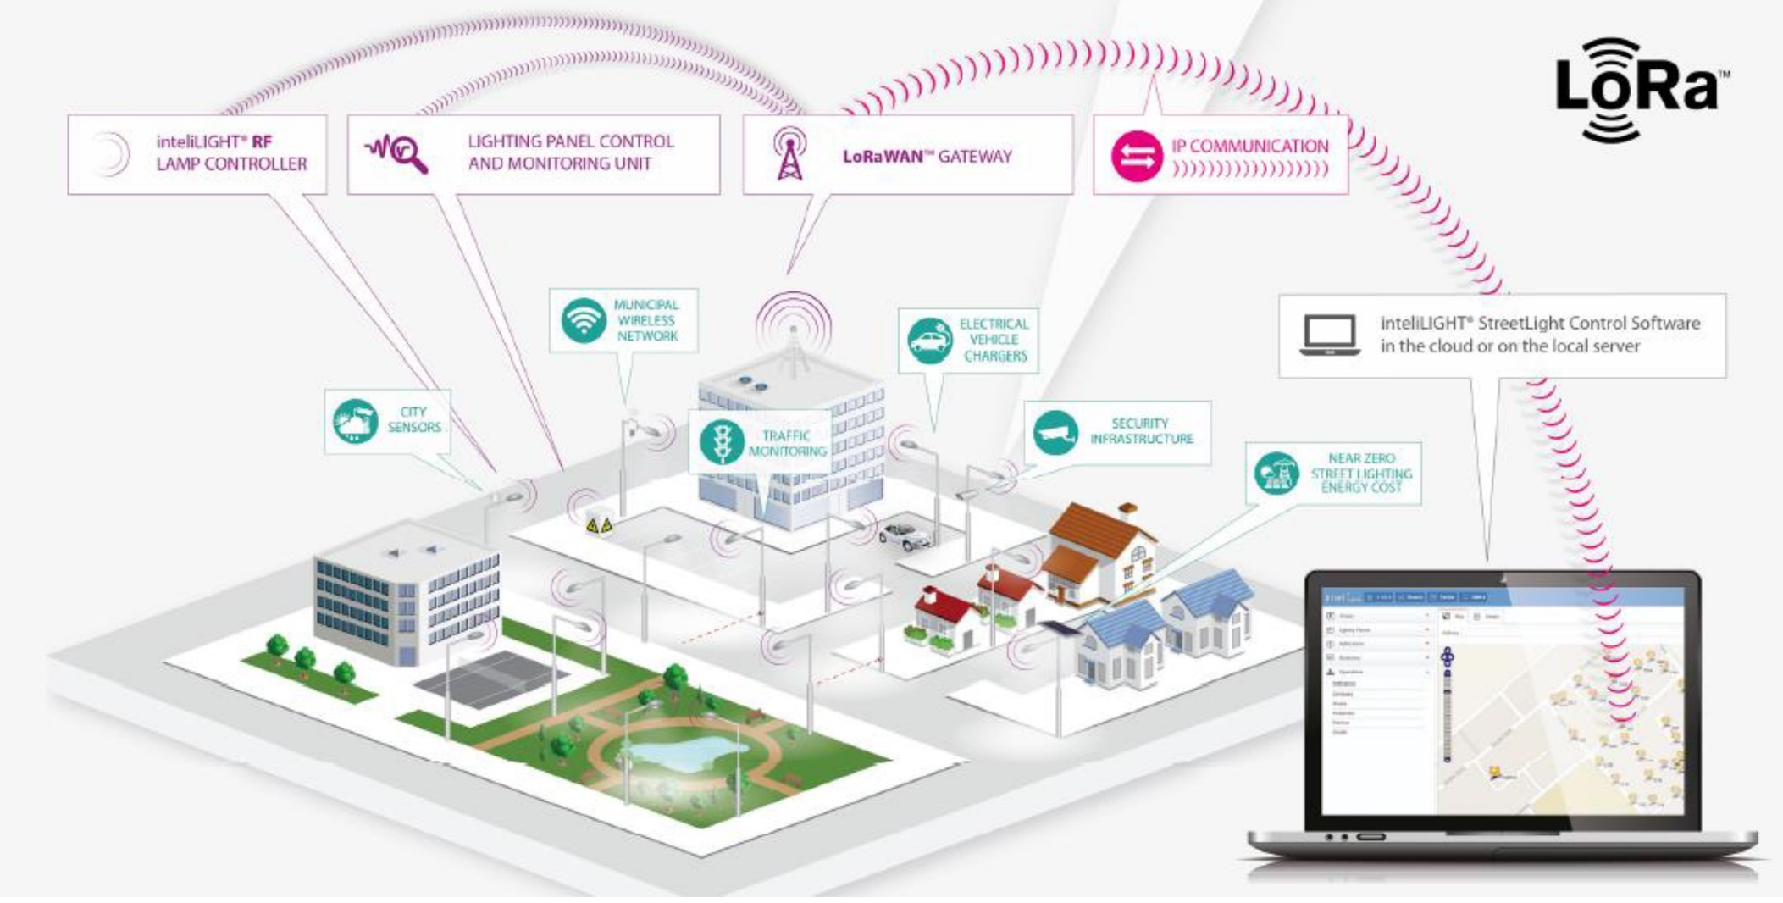
LoRaWAN Use Case- Smart Lighting
IOT and LORAWAN, Quaenet, 2018

Slide 23
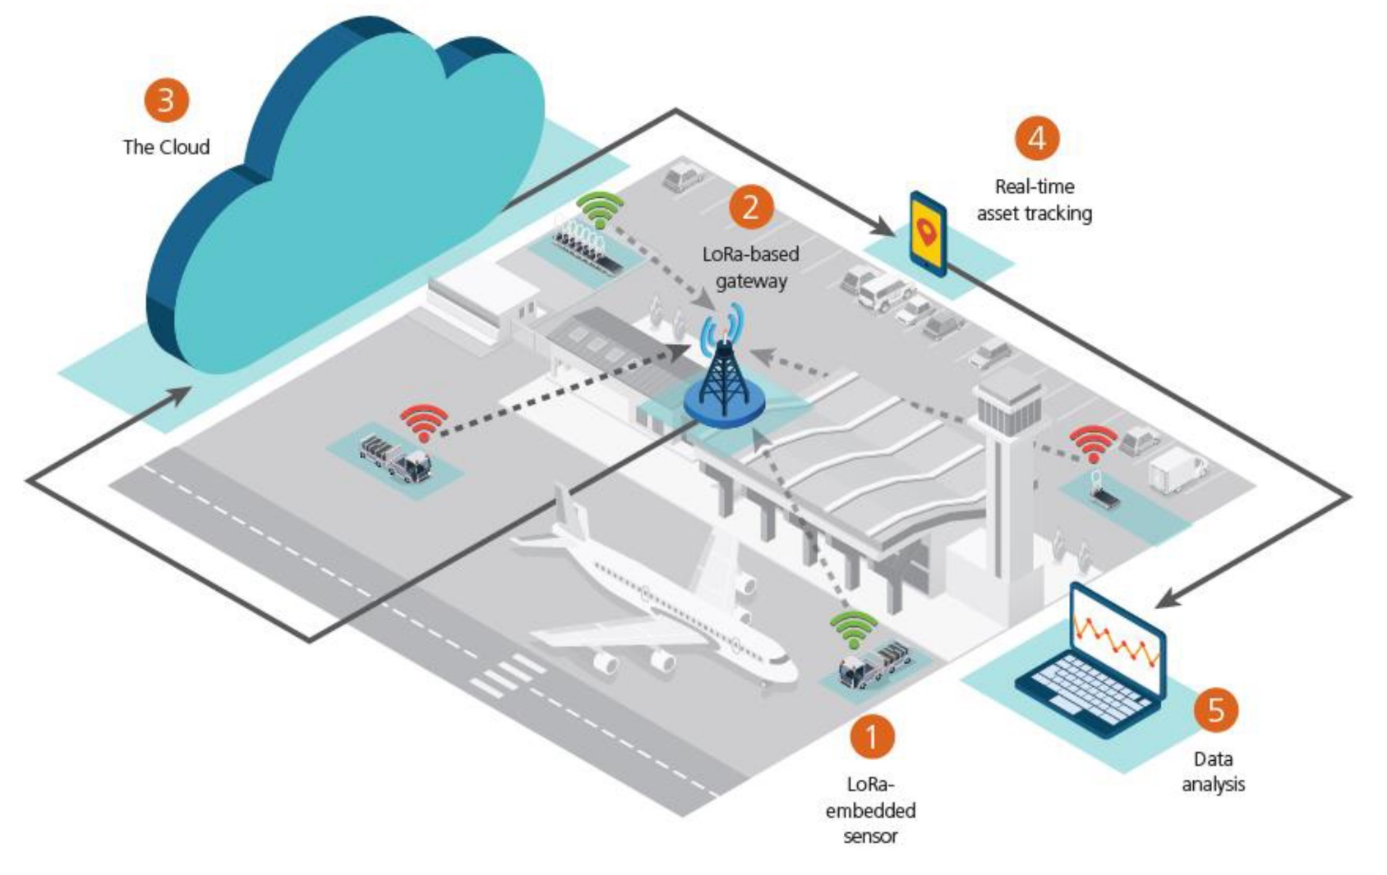
LoRaWAN Use Case- Asset Management
IOT and LORAWAN, Quaenet, 2018

Slide 24
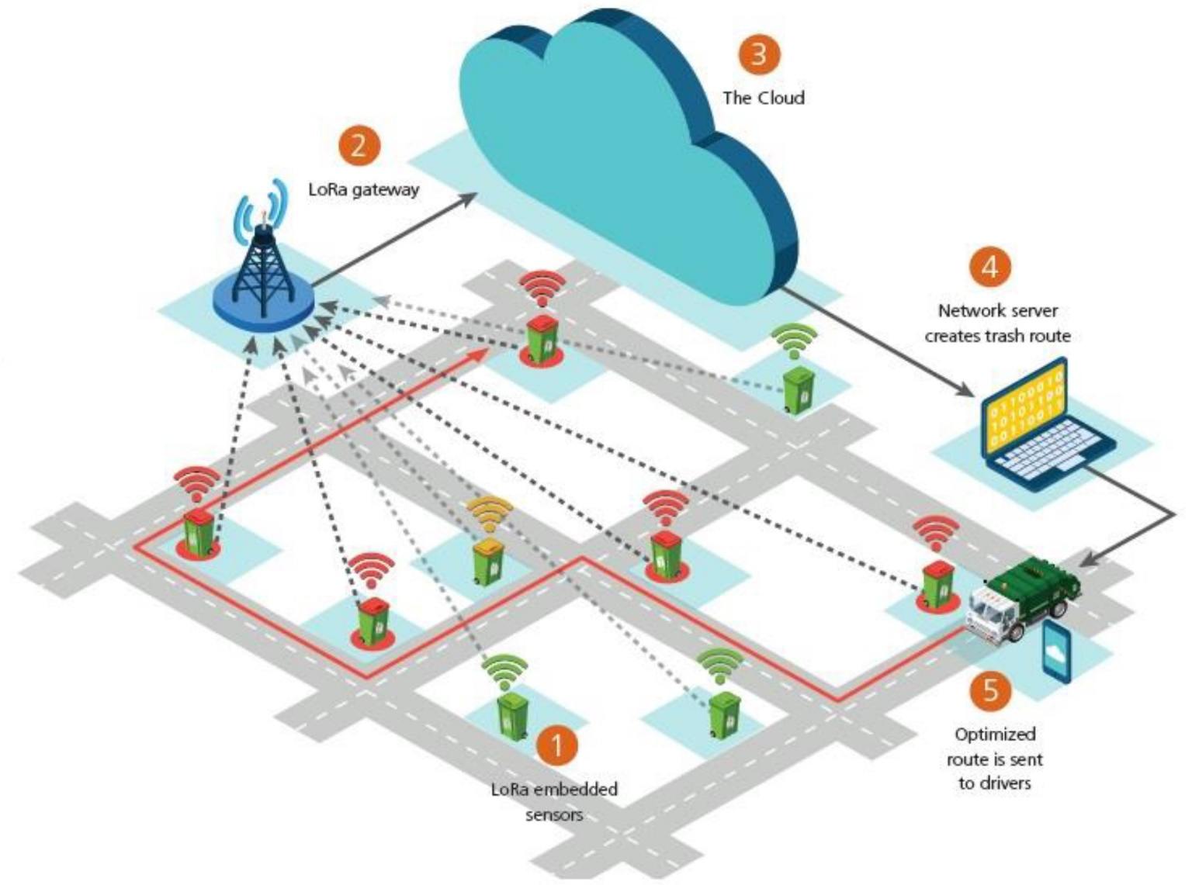
LoRaWAN Use Case- Smart Waste Management
IOT and LORAWAN, Quaenet, 2018

Slide 25
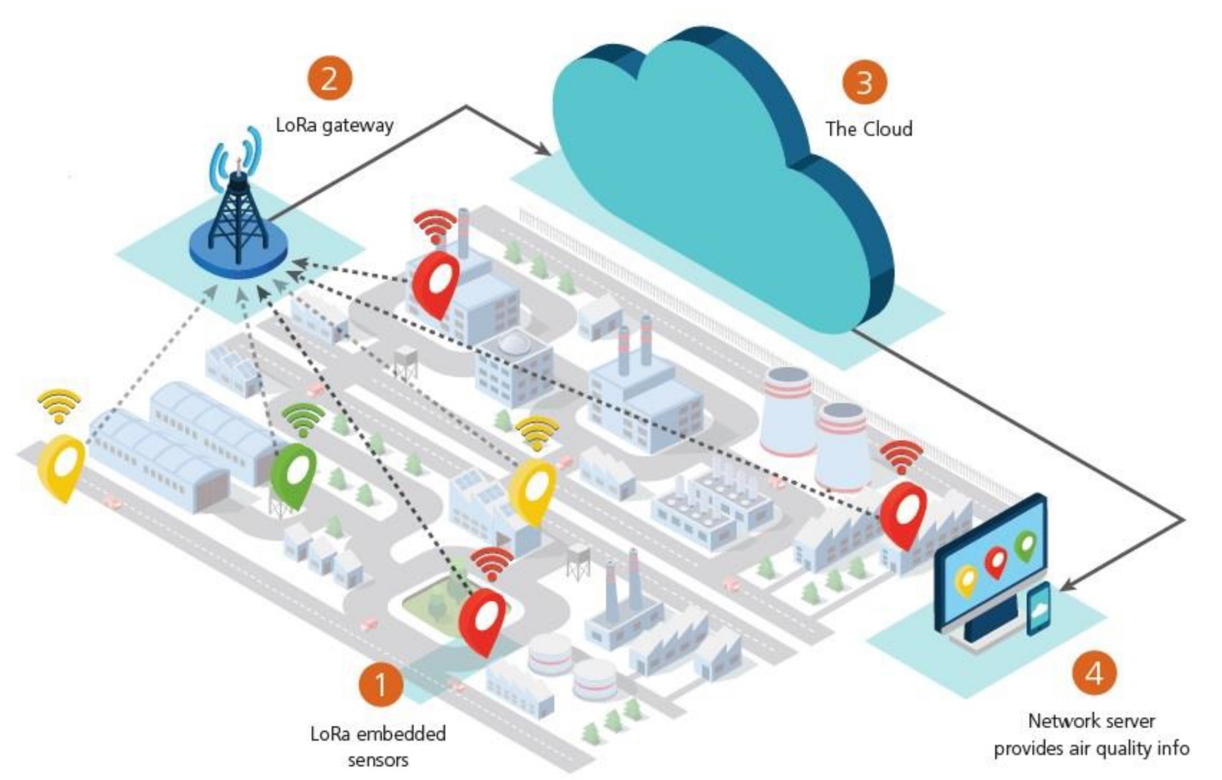
LoRaWAN Use Case- Smart Environment
IOT and LORAWAN, Quaenet, 2018

Slide 26
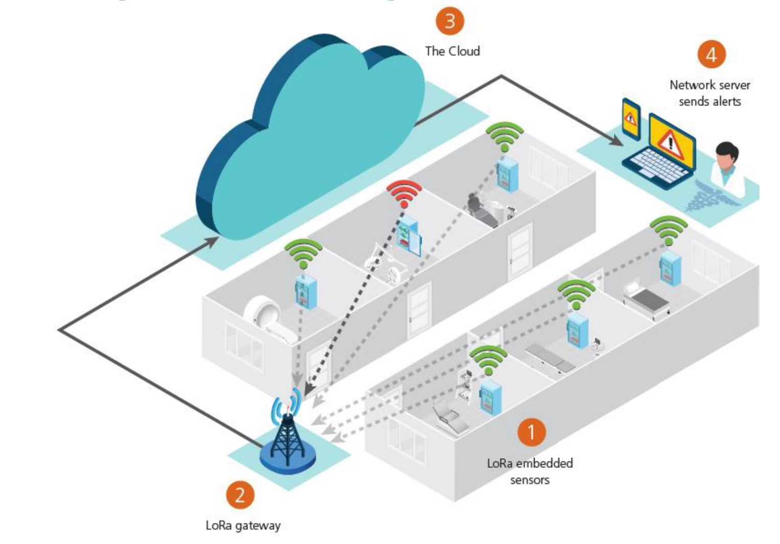
LoRaWAN Use Case- Cold Storage Monitoring
IOT and LORAWAN, Quaenet, 2018

Slide 27
LoRaWAN- Physical Layer
LoRaWAN 1.0.2 regional specifications describe the use of the main unlicensed sub-GHz frequency bands of
433 MHz,
779–787 MHz,
863–870 MHz,
and 902–928 MHz,
as well as regional profiles for a subset of the 902–928 MHz bandwidth
For example, Australia utilizes 915–928 MHz frequency bands, while South Korea uses 920–923 MHz and Japan uses 920–928 MHz.
* IoT Fundamentals: Networking Technologies, Protocols, and Use Cases for the Internet of Thing, Cisco press, 2017
Notes:
Physical Layer
Semtech LoRa modulation is based on chirp spread spectrum modulation, which trades a lower data rate for receiver sensitivity to significantly increase the communication distance. In addition, it allows demodulation below the noise floor, offers robustness to noise and interference, and manages a single channel occupation by different spreading factors. This enables LoRa devices to receive on multiple channels in parallel.
The data rate in LoRaWAN varies depending on the frequency bands and adaptive data rate (ADR). ADR is an algorithm that manages the data rate and radio signal for each endpoint. The ADR algorithm ensures that packets are delivered at the best data rate possible and that network performance is both optimal and scalable. Endpoints close to the gateways with good signal values transmit with the highest data rate, which enables a shorter transmission time over the wireless network, and the lowest transmit power. Meanwhile, endpoints at the edge of the link budget communicate at the lowest data rate and highest transmit power.
An important feature of LoRa is its ability to handle various data rates via the spreading factor. Devices with a low spreading factor (SF) achieve less distance in their communications but transmit at faster speeds, resulting in less airtime. A higher SF provides slower transmission rates but achieves a higher reliability at longer distances.

Slide 28
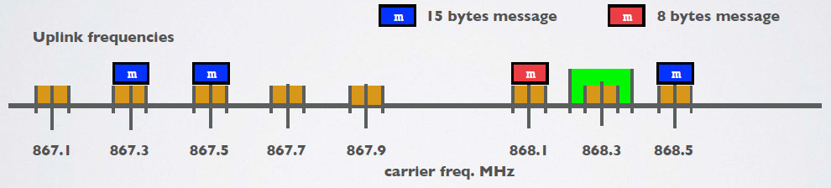
Changing Frequency for Every Transmission
An end device changes channel in a pseudo-random fashion for every transmission. Changing frequencies makes the system more robust to interferences.
For example in Europe for uplink transmissions 8 different frequencies are used.

Slide 29
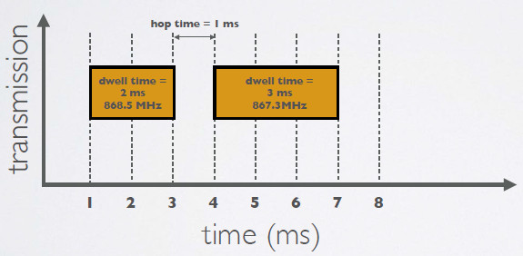
Dwell Time & Hop Time
Dwell time (or transmit time) is the amount of time needed to transmit on a frequency.
Hop time is the amount of time needed to change from one frequency to another in which the radio is not transmitting

Slide 30
ISM Band and Duty Cycle
In Europe when using the ISM band frequencies (863 MHz - 870 MHz) users must comply to the following rules:
For uplink, the maximum transmission power is limited to 25mW (14 dBm).
For downlink (for 869.525MHz), the maximum transmission power is limited to 0.5W (27 dBm)
There is an 0.1% and 1.0% duty cycle per day depending on the channel.
Besides these ISM band rules, the network service provider (for example The Things Network) can also add additional restrictions.

Slide 31
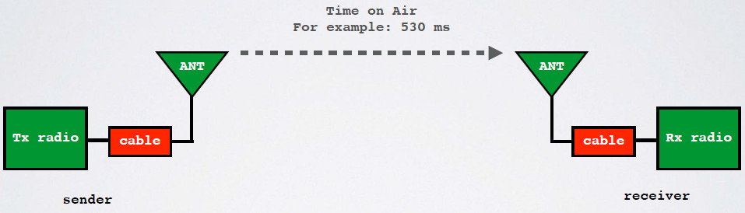
Time on Air (ToA)
When a signal is send from a sender it takes a certain amount of time before a receiver receives this signal. This time is called Time on Air (ToA).

Slide 32
Time on Air (ToA)
Duty cycle is the proportion of time during which a component, device, or system is operated. The duty cycle can be expressed as a ratio or as a percentage.
As mentioned previously in Europe there is a 0.1% and 1.0% duty cycle per day depending on the channel.

Slide 33
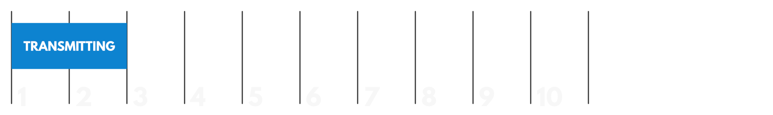
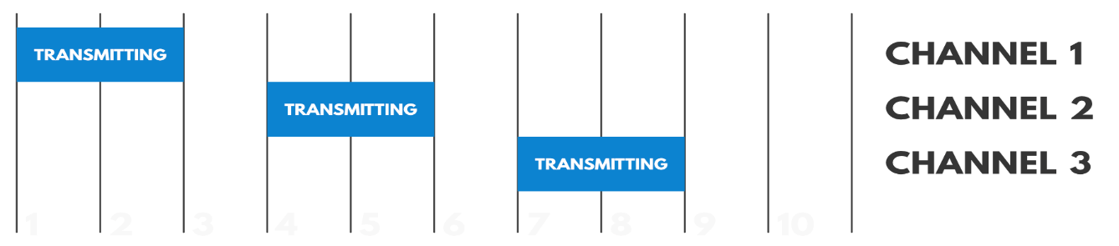
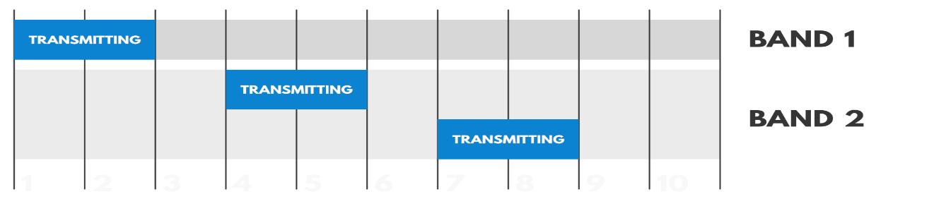
Duty Cycle
Duty-cycle regulations in the ISM bands: The maximum time each device may occupy the channel
duty cycle = 20%
duty cycle = 60%
duty cycle = 20%
duty cycle = 40%
[8] ” Duty Cycle for LoRaWAN Devices”, https://www.thethingsnetwork.org/docs/lorawan/duty-cycle.html

Slide 34
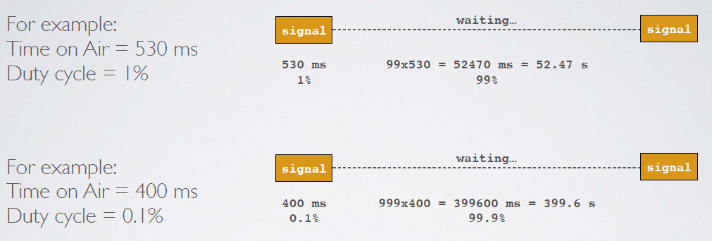
Duty Cycle

Slide 35
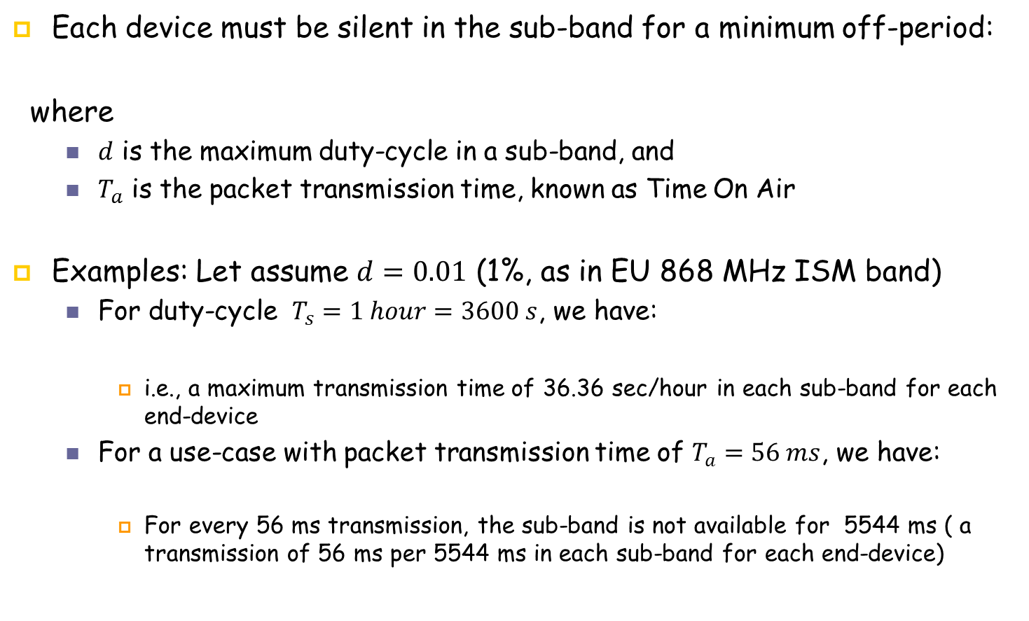
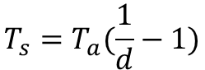
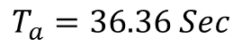
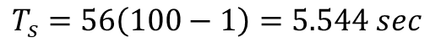
Duty Cycle
sdsdsd
[9] Ferran Adelantado,Xavier Vilajosana,Pere Tuset-Peiro,Borja Martinez,and oan Melia, “Understanding the limits of LoRaWAN”, IEEE Communications Magazine, 8 September 2017, Vol.55

Slide 36
LoRaWAN- Physical Layer
Semtech LoRa modulation is based on chirp spread spectrum modulation, which trades a lower data rate for receiver sensitivity to significantly increase the communication distance.
It allows demodulation below the noise floor, offers robustness to noise and interference, and manages a single channel occupation by different spreading factors.
An important feature of LoRa is its ability to handle various data rates via the spreading factor.
* IoT Fundamentals: Networking Technologies, Protocols, and Use Cases for the Internet of Thing, Cisco press, 2017
Notes:
Physical Layer
Semtech LoRa modulation is based on chirp spread spectrum modulation, which trades a lower data rate for receiver sensitivity to significantly increase the communication distance. In addition, it allows demodulation below the noise floor, offers robustness to noise and interference, and manages a single channel occupation by different spreading factors. This enables LoRa devices to receive on multiple channels in parallel.
The data rate in LoRaWAN varies depending on the frequency bands and adaptive data rate (ADR). ADR is an algorithm that manages the data rate and radio signal for each endpoint. The ADR algorithm ensures that packets are delivered at the best data rate possible and that network performance is both optimal and scalable. Endpoints close to the gateways with good signal values transmit with the highest data rate, which enables a shorter transmission time over the wireless network, and the lowest transmit power. Meanwhile, endpoints at the edge of the link budget communicate at the lowest data rate and highest transmit power.
An important feature of LoRa is its ability to handle various data rates via the spreading factor. Devices with a low spreading factor (SF) achieve less distance in their communications but transmit at faster speeds, resulting in less airtime. A higher SF provides slower transmission rates but achieves a higher reliability at longer distances.

Slide 37
LoRaWAN- Physical Layer
In most cases LoRaWAN uses LoRa modulation.
LoRa modulation is based on Chirp spread- spectrum technology, which makes it work well with channel noise, multipath fading and the Doppler effect, even at low power.
The data rate depends on
bandwidth
spreading factor
LoRaWAN can use channels with a bandwidth of either 125 kHz, 250 kHz or 500 kHz, depending on the region or the frequency plan.
The spreading factor is chosen (SF7 to SF12) by the end-device and influences the time it takes to transmit a frame.

Slide 38
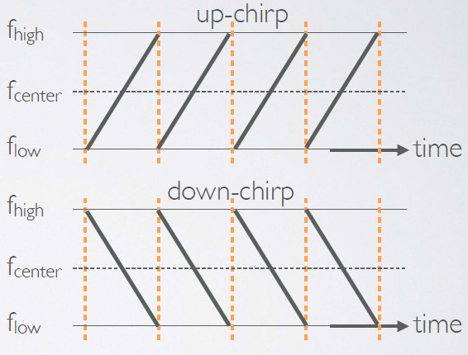
LoRaWAN- Physical Layer: Chirps
Example of an up-chirp where the frequency increases in time.

Slide 39
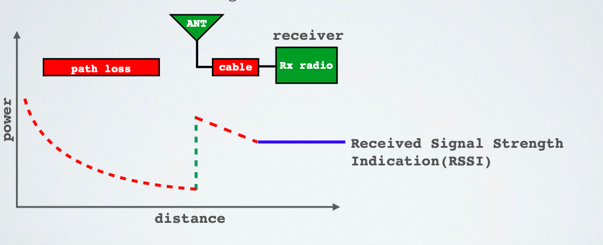
LoRaWAN- Physical Layer
The Received Signal Strength Indication (RSSI) is the received signal power in milliwatts and is measured in dBm. This value can be used as a measurement of how well a receiver can “hear” a signal from a sender.
The RSSI is measured in dBm and is a negative value. The closer to 0 the better the signal is.
* https://www.mobilefish.com/developer/lorawan/lorawan_quickguide_tutorial.html

Slide 40
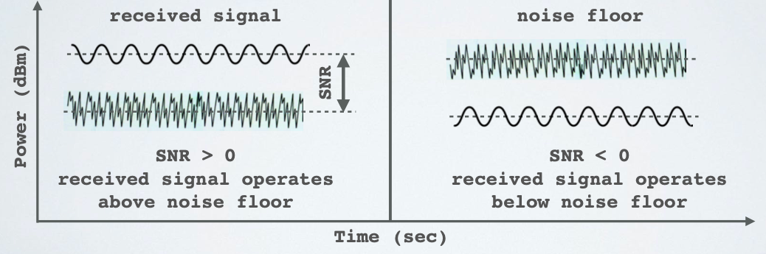
LoRaWAN- Physical Layer
Signal-to-Noise Ratio (SNR) is the ratio between the received power signal and the noise floor power level.
The noise floor is an area of all unwanted interfering signal sources which can corrupt the transmitted signal and therefore re-transmissions will occur.
Typical LoRa SNR values are between: -20dB and +10dB

Slide 41
LoRaWAN- Physical Layer
Semtech LoRa modulation is based on chirp spread spectrum modulation, which trades a lower data rate for receiver sensitivity to significantly increase the communication distance.
It allows demodulation below the noise floor, offers robustness to noise and interference, and manages a single channel occupation by different spreading factors.
An important feature of LoRa is its ability to handle various data rates via the spreading factor.
* IoT Fundamentals: Networking Technologies, Protocols, and Use Cases for the Internet of Thing, Cisco press, 2017
Notes:
Physical Layer
Semtech LoRa modulation is based on chirp spread spectrum modulation, which trades a lower data rate for receiver sensitivity to significantly increase the communication distance. In addition, it allows demodulation below the noise floor, offers robustness to noise and interference, and manages a single channel occupation by different spreading factors. This enables LoRa devices to receive on multiple channels in parallel.
The data rate in LoRaWAN varies depending on the frequency bands and adaptive data rate (ADR). ADR is an algorithm that manages the data rate and radio signal for each endpoint. The ADR algorithm ensures that packets are delivered at the best data rate possible and that network performance is both optimal and scalable. Endpoints close to the gateways with good signal values transmit with the highest data rate, which enables a shorter transmission time over the wireless network, and the lowest transmit power. Meanwhile, endpoints at the edge of the link budget communicate at the lowest data rate and highest transmit power.
An important feature of LoRa is its ability to handle various data rates via the spreading factor. Devices with a low spreading factor (SF) achieve less distance in their communications but transmit at faster speeds, resulting in less airtime. A higher SF provides slower transmission rates but achieves a higher reliability at longer distances.

Slide 42
LoRaWAN- Physical Layer
In most cases LoRaWAN uses LoRa modulation.
LoRa modulation is based on Chirp spread- spectrum technology, which makes it work well with channel noise, multipath fading and the Doppler effect, even at low power.
The data rate depends on
bandwidth
spreading factor
LoRaWAN can use channels with a bandwidth of either 125 kHz, 250 kHz or 500 kHz, depending on the region or the frequency plan.
The spreading factor is chosen (SF7 to SF12) by the end-device and influences the time it takes to transmit a frame.

Slide 43
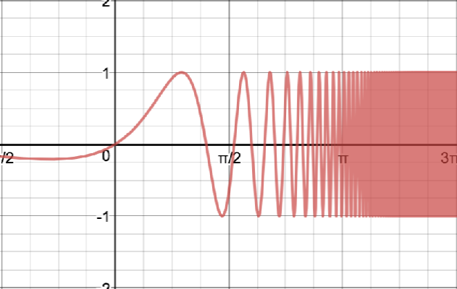
LoRaWAN- Physical Layer: Chirps
Example of an up-chirp where the frequency increases in time.

Slide 44
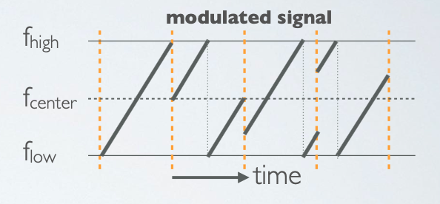
LoRaWAN- Physical Layer: Chirps
The chirps are cyclically-shifted, and it is the frequency jumps that determines how the data is encoded onto the chirps, aka LoRa modulation.

Slide 45
LoRaWAN- Physical Layer
A symbol represents one, or more bits of data, for example: Symbol = 1011111 (decimal = 95)
In the example above the number of raw bits that can be encoded by the symbol is 7. This is the same as saying: Spreading Factor (SF) = 7
The symbol has 2^{SF} values. If SF=7, the values ranges from 0 - 127.
The symbol value is encoded onto a sweep signal (up-chirp).

Slide 46
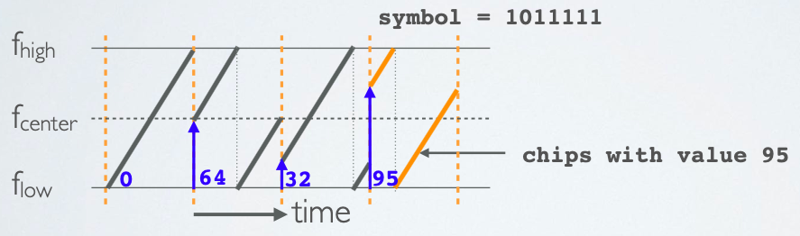
LoRaWAN- Physical Layer
The sweep signal is divided into 2^{SF} steps or chips.
For example if the symbol is: 1011111 (decimal value = 95), the number of raw bits that can be encoded by this symbol is 7 (SF=7) and the sweep signal is divided in 2^{SF} = 2⁷ = 128 chips.

Slide 47
LoRaWAN- Physical Layer
Bandwidth is interchangeable with chip rate:
BW = RC = chip rate (chips/s)
For example: if BW = 125 kHz, then BW = RC = 125000 chips/s
The Symbol Rate (R_{s}) is calculated as follow: R_{s} (symbols/sec) = BW / 2^{SF}= R_{c} / 2^{SF}
For example: If BW = 125 kHz, SF=7, then R_{s} = 125000 / 2⁷ = 977 symbols/sec
The symbol duration or sweep time is calculated as follow: T_{s}(sec) = 2^{SF} / BW

Slide 48
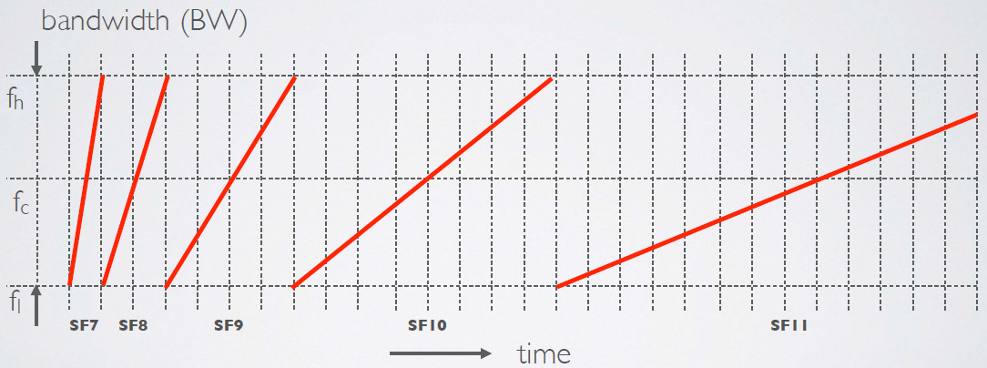
LoRaWAN- Physical Layer
An overview of symbol durations with respect to different Spreading Factors.
If the SF increases by one the symbol duration doubles.

Slide 49
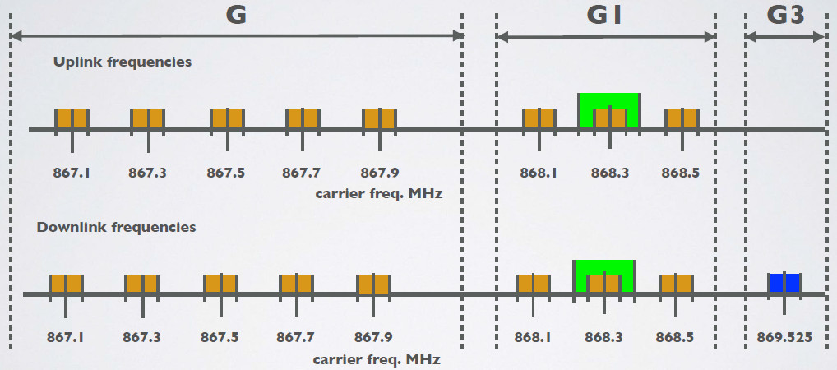
LoRaWAN- Physical Layer: EU863-870 Frequency and Sub-bands

Slide 50
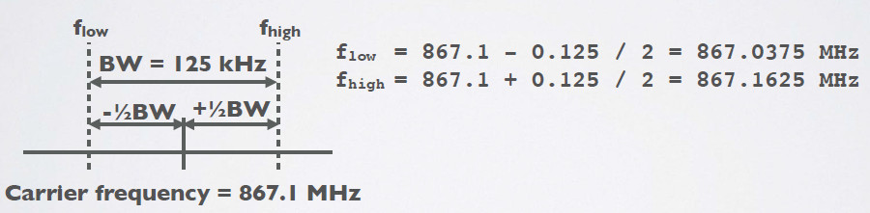
LoRaWAN- Physical Layer: Bandwidth
LoRaWAN only uses the following bandwidth ranges: 125 kHz, 250 kHz and 500 kHz. Which of these 3 ranges are actual used depends on the region or frequency plan. For example in Europe only the bandwidths 125kHz and 250 kHz are used.
The relationship between bandwidth and carrier frequency can be seen in the figure below.

Slide 51
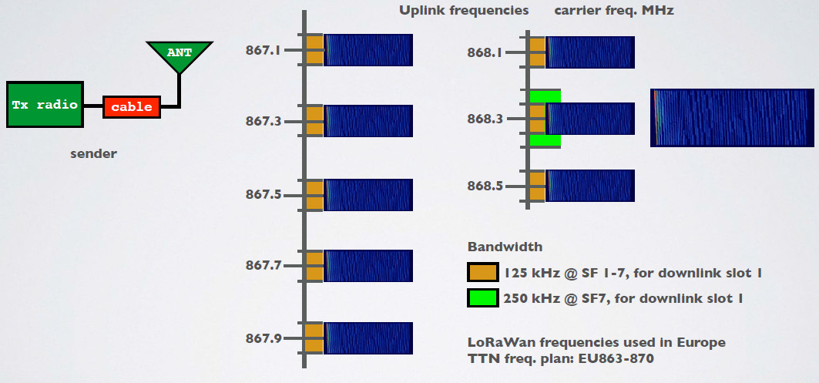
LoRaWAN- Physical Layer: Carriers Frequency and Bandwidth

Slide 52
LoRaWAN- Physical Layer
The Data Rate Story: There are three physical factors:
transmission power,
bandwidth
spreading factor
If you lower the tx power, you’ll save battery, but the range of the signal will obviously be shorter.
The other two factors (spreading factor and bandwidth) combined form the data rate. This determines how fast bytes are transmitted.

Slide 53
LoRaWAN- Physical Layer
If you increase the data rate (make the bandwidth wider or the spreading factor lower) you can transmit those bytes in a shorter time.
Making the bandwidth 2x wider (from BW125 to BW250) approximately allows you to send 2x more bytes in the same time.

Slide 54
LoRaWAN- Physical Layer
Spreading Factor
Devices with a low spreading factor (SF) achieve less distance in their communications but transmit at faster speeds, resulting in less airtime.
A higher SF provides slower transmission rates but achieves a higher reliability at longer distances.
Making the spreading factor 1 step lower (ex. from SF10 to SF9) allows you to send 2x more bytes in the same time.
Lowering the spreading factor makes it more difficult for the gateway to receive a transmission, as it will be more sensitive to noise.
You could compare this to two people taking in a noisy place. If you’re far from each other, you have to talk slow (SF10), but if you’re close, you can talk faster (SF7)
* IoT Fundamentals: Networking Technologies, Protocols, and Use Cases for the Internet of Thing, Cisco press, 2017
Notes:
Physical Layer
Semtech LoRa modulation is based on chirp spread spectrum modulation, which trades a lower data rate for receiver sensitivity to significantly increase the communication distance. In addition, it allows demodulation below the noise floor, offers robustness to noise and interference, and manages a single channel occupation by different spreading factors. This enables LoRa devices to receive on multiple channels in parallel.
The data rate in LoRaWAN varies depending on the frequency bands and adaptive data rate (ADR). ADR is an algorithm that manages the data rate and radio signal for each endpoint. The ADR algorithm ensures that packets are delivered at the best data rate possible and that network performance is both optimal and scalable. Endpoints close to the gateways with good signal values transmit with the highest data rate, which enables a shorter transmission time over the wireless network, and the lowest transmit power. Meanwhile, endpoints at the edge of the link budget communicate at the lowest data rate and highest transmit power.
An important feature of LoRa is its ability to handle various data rates via the spreading factor. Devices with a low spreading factor (SF) achieve less distance in their communications but transmit at faster speeds, resulting in less airtime. A higher SF provides slower transmission rates but achieves a higher reliability at longer distances.

Slide 55
LoRaWAN- Physical Layer

Slide 56
LoRaWAN- Physical Layer
http://www.linuxembedded.fr/2017/12/introduction-a-lora/

Slide 57
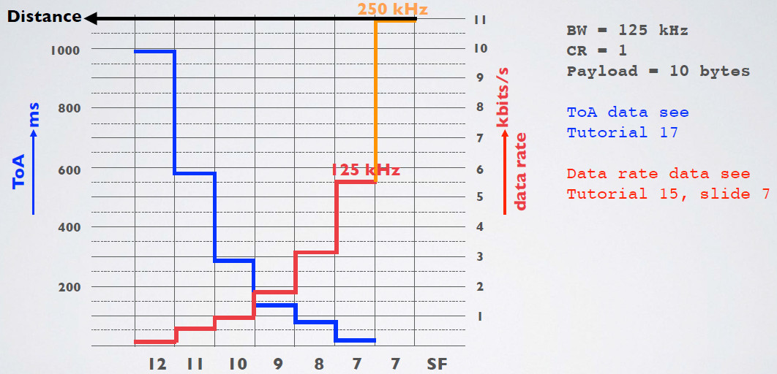
Time on Air

Slide 58
LoRaWAN- Physical Layer

Slide 59
LoRaWAN- Adaptive Data Rate
Adaptive Data Rate (ADR) is a mechanism for optimizing data rates, airtime and energy consumption in the network.
End devices decide if ADR should be used or not, not the application or the network.

Slide 60
Adaptive Data Rate
The LoRaWAN protocol defines the Adaptive Data Rate (ADR) scheme to control
the uplink transmission parameters of LoRa devices:
- Spreading Factor (SF)
- Bandwidth (BW) Transmission parameters
- Transmission power
Whether the ADR functionality will be used is requested by the end nodes by setting the ADR flag in the uplink message. If the ADR flag is set, the network server can control the end node’s transmission parameters.
ADR should only be used in stable Radio Frequency (RF) situations where end nodes do not move. Mobile end nodes which are stationary for longer times can enable ADR during those times.
Notes:
To determine the optimal data rate, the network needs some measurements (uplink messages). Currently TTN takes the 20 most recent uplinks, starting at the moment the ADR bit is set. These measurements contains the frame counter, signal-to-noise ratio (SNR) and number of gateways that received each uplink. When a device unsets the ADR bit (because it knows it is moving or it knows RF conditions are unstable), previous measurements are discarded. As soon as the ADR bit is set again, the network starts measuring again.
For each of these measurements, we take the SNR of the best gateway, and we calculate the so-called “margin”, which is the measured SNR minus the required SNR to demodulate a message given the data rate. This margin is used to determine how much we can increase the data rate or lower the transmit power. For example, when the network receives a message with data rate SF12BW125 and SNR 5.0, that message has a margin of 25 dB. This is a waste of valuable airtime and energy. If we would increase the data rate to SF7BW125 we would still have a margin of 12.5 dB, but that would be many times more airtime- and energy efficient. We could even lower the transmit power to save even more energy and cause less interference.

Slide 61
LoRaWAN- Adaptive Data Rate
To determine the optimal data rate, the network needs some measurements (uplink messages). Currently TTN takes the 20 most recent uplinks, starting at the moment the ADR bit is set. These measurements contains the frame counter, signal-to-noise ratio (SNR) and number of gateways that received each uplink. When a device unsets the ADR bit (because it knows it is moving or it knows RF conditions are unstable), previous measurements are discarded. As soon as the ADR bit is set again, the network starts measuring again.
For each of these measurements, we take the SNR of the best gateway, and we calculate the so-called “margin”, which is the measured SNR minus the required SNR to demodulate a message given the data rate. This margin is used to determine how much we can increase the data rate or lower the transmit power. For example, when the network receives a message with data rate SF12BW125 and SNR 5.0, that message has a margin of 25 dB. This is a waste of valuable airtime and energy. If we would increase the data rate to SF7BW125 we would still have a margin of 12.5 dB, but that would be many times more airtime- and energy efficient. We could even lower the transmit power to save even more energy and cause less interference.

Slide 62
LoRaWAN- MAC Layer
LoRaWAN- MAC layer
This layer takes advantage of the LoRa physical layer and classifies LoRaWAN endpoints to optimize their battery life and ensure downstream communications to the LoRaWAN endpoints.
The classes of LoRaWAN devices:
Class A: This class is the default implementation. Optimized for battery-powered nodes, it allows bidirectional communications.
Class B: A Class B node or endpoint should get additional receive windows compared to Class A, but gateways must be synchronized through a beaconing process.
Class C: This class is particularly adapted for powered nodes.
* IoT Fundamentals: Networking Technologies, Protocols, and Use Cases for the Internet of Thing, Cisco press, 2017
Notes:
MAC layer
This layer takes advantage of the LoRa physical layer and classifies LoRaWAN endpoints to optimize their battery life and ensure downstream communications to the LoRaWAN endpoints. The LoRaWAN specification documents three classes of LoRaWAN devices:
Class A: This class is the default implementation. Optimized for battery-powered nodes, it allows bidirectional communications, where a given node is able to receive downstream traffic after transmitting. Two receive windows are available after each transmission.
Class B: This class was designated “experimental” in LoRaWAN 1.0.1 until it can be better defined. A Class B node or endpoint should get additional receive windows compared to Class A, but gateways must be synchronized through a beaconing process.
Class C: This class is particularly adapted for powered nodes. This classification enables a node to be continuously listening by keeping its receive window open when not transmitting.

Slide 63
LoRaWAN- MAC Layer
Class A
UL anytime, DL only at well-defined slots after UL
Battery-powered sensors
Class B
UL anytime, DL at scheduled slots
Battery-powered actuators
Class C
UL and DL anytime
Mains-powered devices.
Notes:
MAC layer
This layer takes advantage of the LoRa physical layer and classifies LoRaWAN endpoints to optimize their battery life and ensure downstream communications to the LoRaWAN endpoints. The LoRaWAN specification documents three classes of LoRaWAN devices:
Class A: This class is the default implementation. Optimized for battery-powered nodes, it allows bidirectional communications, where a given node is able to receive downstream traffic after transmitting. Two receive windows are available after each transmission.
Class B: This class was designated “experimental” in LoRaWAN 1.0.1 until it can be better defined. A Class B node or endpoint should get additional receive windows compared to Class A, but gateways must be synchronized through a beaconing process.
Class C: This class is particularly adapted for powered nodes. This classification enables a node to be continuously listening by keeping its receive window open when not transmitting.

Slide 64
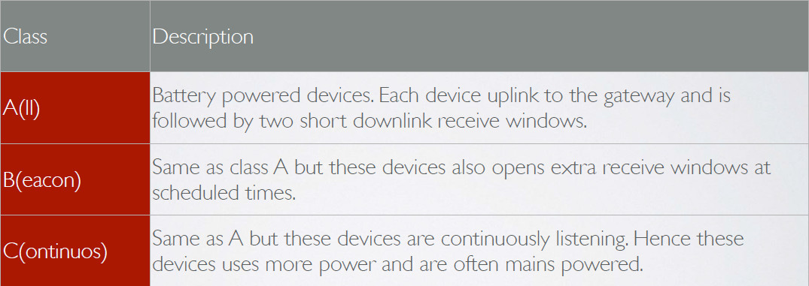
LoRaWAN Device Classes
The LoRaWAN specification defines three device classes:

Slide 65
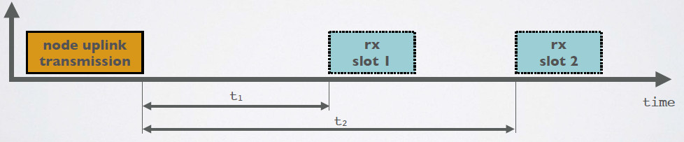
CLASS A
At any time an end node can broadcast a signal. After this uplink transmission (tx) the end node will listen for a response from the gateway.
The end node opens two receive slots at t1 and t2 seconds after an uplink transmission. The gateway can respond within the first receive slot or the second receive slot, but not both.
Class B and C devices must also support class A functionality.

Slide 66
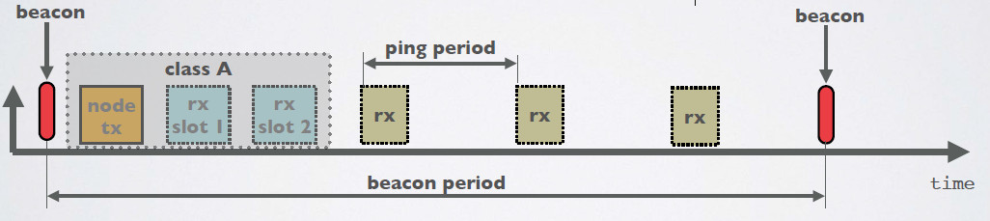
CLASS B
In addition to Class A receive slots, class B devices opens extra receive slots at scheduled times.
The end node receives a time synchronized beacon from the gateway, allowing the gateway to know when the node is listening.
A class B device does not support device C functionality.

Slide 67
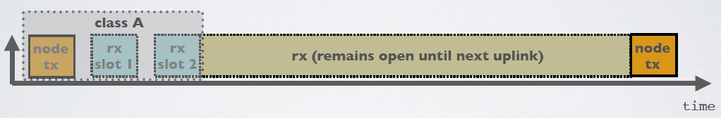
CLASS C
In addition to Class A receive slots a class C device will listen continuously for responses from the gateway.
A class C device does not support device B functionality.

Slide 68
LoRaWAN Device Classes
LoRaWAN Protocol End-Device Classes
J. Silva, etl, LoRaWAN - A Low Power WAN Protocol for Internet of Things: a Review and Opportunities, 2th Int. Multidisciplinary Conf. on Computer and Energy Science, 2017

Slide 69
LoRaWAN Device Classes
LoRaWAN Protocol End-Device Classes
J. Silva, etl, LoRaWAN - A Low Power WAN Protocol for Internet of Things: a Review and Opportunities, 2th Int. Multidisciplinary Conf. on Computer and Energy Science, 2017

Slide 70
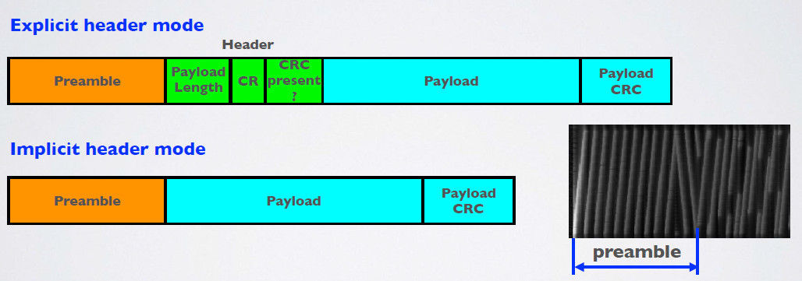
LorRa Packet Format
The LoRa packet comprises of three elements: Preamble, header (optional) and payload.

Slide 71
LorRa Frame Format
The LoRa packet comprises of three elements: Preamble, header (optional) and payload.

Slide 72
LorRa Packet Format
There are two types of LoRa packet format modes:
Explicit header mode:
Includes a short header that contains information about the payload length, coding rate and whether a CRC is used in the packet.
CRC stands for Cyclic Redundancy Check and is used to detect errors in digital data.
Implicit header mode
Where the payload, coding rate and CRC presence are fixed. In this mode the header is removed from the packet thus reducing transmission time.
In this case the payload length, error coding rate and presence of the payload CRC must be manually configured on both sides of the radio link.

Slide 73
LorRa Packet Format
The preamble is used to detect the start of the packet by the receiver.
The header (only in explicit header mode) is the default mode of operation. It provides information on the payload:
- The payload length in bytes.
- The forward error correction code rate.
- The presence of an optional 16 bits CRC for the payload.
The payload is a variable-length field that contains the actual data coded at the forward error correction code rate either as specified in the header in explicit mode or fixed in implicit mode. An optional payload CRC may be appended.

Slide 74
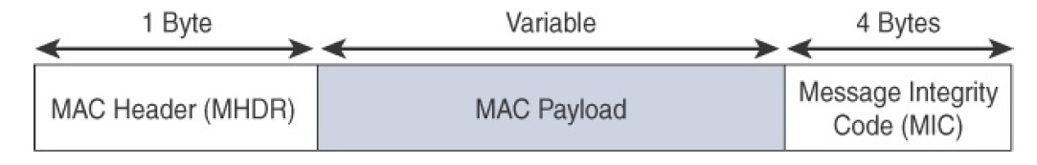
LoRaWAN- MAC Layer
LoRaWAN- MAC layer
LoRaWAN messages, have a
The MAC payload size depends on the frequency band and the data rate, ranging from 59 to 230 bytes for the 863–870 MHz band and 19 to 250 bytes for the 902–928 MHz band.
* IoT Fundamentals: Networking Technologies, Protocols, and Use Cases for the Internet of Thing, Cisco press, 2017
Notes:
MAC layer
LoRaWAN messages, either uplink or downlink, have a PHY payload composed of a 1-byte MAC header, a variable-byte MAC payload, and a MIC that is 4 bytes in length. The MAC payload size depends on the frequency band and the data rate, ranging from 59 to 230 bytes for the 863–870 MHz band and 19 to 250 bytes for the 902–928 MHz band.
LoRaWAN endpoints are uniquely addressable through a variety of methods, including the following:
An endpoint can have a global end device ID or DevEUI represented as an IEEE EUI-64 address.
An endpoint can have a global application ID or AppEUI represented as an IEEE EUI-64 address that uniquely identifies the application provider, such as the owner, of the end device.
In a LoRaWAN network, endpoints are also known by their end device address, known as a DevAddr, a 32-bit address. The 7 most significant bits are the network identifier (NwkID), which identifies the LoRaWAN network. The 25 least significant bits are used as the network address (NwkAddr) to identify the endpoint in the network.

Slide 75
Direct Communication Between Devices
• The LoRaWAN protocol does not support direct communication between end nodes.
• If you want direct communication between LoRa devices without the use of gateways, use the RadioHead Packet Radio library for embedded microprocessors. It provides a complete object-oriented library for sending and receiving packet sized messages via a variety of radios such as LoRa on a range of embedded microprocessors: https://www.airspayce.com/mikem/arduino/RadioHead/
RadioHead does not have an official GitHub repo but several people have cloned the Radiohead library on GitHub.

Slide 76
LoRaWAN- Security
LoRaWAN considers two layers of security, one for the network and another for the applications.
Each end-device has key assignments done by device manufacturers or the application owners.
Other systems use a single key for encryption and authentication, compared to LoRaWAN.
Authentication and encryption are separate, so it is possible to authenticate packets and provide integrity protection.
J. Silva, etl, LoRaWAN - A Low Power WAN Protocol for Internet of Things: a Review and Opportunities, 2th Int. Multidisciplinary Conf. on Computer and Energy Science, 2017
Notes:
MAC layer
LoRaWAN messages, either uplink or downlink, have a PHY payload composed of a 1-byte MAC header, a variable-byte MAC payload, and a MIC that is 4 bytes in length. The MAC payload size depends on the frequency band and the data rate, ranging from 59 to 230 bytes for the 863–870 MHz band and 19 to 250 bytes for the 902–928 MHz band.
LoRaWAN endpoints are uniquely addressable through a variety of methods, including the following:
An endpoint can have a global end device ID or DevEUI represented as an IEEE EUI-64 address.
An endpoint can have a global application ID or AppEUI represented as an IEEE EUI-64 address that uniquely identifies the application provider, such as the owner, of the end device.
In a LoRaWAN network, endpoints are also known by their end device address, known as a DevAddr, a 32-bit address. The 7 most significant bits are the network identifier (NwkID), which identifies the LoRaWAN network. The 25 least significant bits are used as the network address (NwkAddr) to identify the endpoint in the network.

Slide 77
LoRaWAN- Security
Logical data Flow:
J. Silva, etl, LoRaWAN - A Low Power WAN Protocol for Internet of Things: a Review and Opportunities, 2th Int. Multidisciplinary Conf. on Computer and Energy Science, 2017
Notes:
MAC layer
LoRaWAN messages, either uplink or downlink, have a PHY payload composed of a 1-byte MAC header, a variable-byte MAC payload, and a MIC that is 4 bytes in length. The MAC payload size depends on the frequency band and the data rate, ranging from 59 to 230 bytes for the 863–870 MHz band and 19 to 250 bytes for the 902–928 MHz band.
LoRaWAN endpoints are uniquely addressable through a variety of methods, including the following:
An endpoint can have a global end device ID or DevEUI represented as an IEEE EUI-64 address.
An endpoint can have a global application ID or AppEUI represented as an IEEE EUI-64 address that uniquely identifies the application provider, such as the owner, of the end device.
In a LoRaWAN network, endpoints are also known by their end device address, known as a DevAddr, a 32-bit address. The 7 most significant bits are the network identifier (NwkID), which identifies the LoRaWAN network. The 25 least significant bits are used as the network address (NwkAddr) to identify the endpoint in the network.

Slide 78
IoT wireless technologies overview
End-device address (DevAddr):
Application identifier (AppEUI): A global application ID in the IEEE EUI64 address space that uniquely identifies the owner of the end-device.
Network session key (NwkSKey): A key used by the network server and the end-device to calculate and verify the message integrity code of all data messages to ensure data integrity.
Application session key (AppSKey): A key used by the network server and end-device to encrypt and decrypt the payload field of data messages.
S. Tabbane, IoT systems overview, ITU

Slide 79
LoRaWAN- Security
The first layer, called “network security” but applied at the MAC layer, guarantees the authentication of the endpoints by the LoRaWAN network server.
Also, it protects LoRaWAN packets by performing encryption based on AES.
Each endpoint implements a network session key (NwkSKey), used by both itself and the LoRaWAN network server.
The NwkSKey ensures data integrity through computing and checking the MIC of every data message as well as encrypting and decrypting MAC-only data message payloads.
* IoT Fundamentals: Networking Technologies, Protocols, and Use Cases for the Internet of Thing, Cisco press, 2017

Slide 80
LoRaWAN- Security
The second layer is an application session key (AppSKey), which performs encryption and decryption functions between the endpoint and its application server.
Furthermore, it computes and checks the application-level MIC, if included. This ensures that the LoRaWAN service provider does not have access to the application payload if it is not allowed that access.
Endpoints receive their AES-128 application key (AppKey) from the application owner. This key is most likely derived from an application specific root key exclusively known to and under the control of the application provider.
* IoT Fundamentals: Networking Technologies, Protocols, and Use Cases for the Internet of Thing, Cisco press, 2017

Slide 81
LoRaWAN- Security
LoRaWAN endpoints must implement two layers of security:
J. Silva, etl, LoRaWAN - A Low Power WAN Protocol for Internet of Things: a Review and Opportunities, 2th Int. Multidisciplinary Conf. on Computer and Energy Science, 2017

Slide 82
LoRaWAN- Security
LoRaWAN endpoints must implement two layers of security, protecting communications and data privacy across the network.
* IoT Fundamentals: Networking Technologies, Protocols, and Use Cases for the Internet of Thing, Cisco press, 2017
Notes:
MAC layer
LoRaWAN messages, either uplink or downlink, have a PHY payload composed of a 1-byte MAC header, a variable-byte MAC payload, and a MIC that is 4 bytes in length. The MAC payload size depends on the frequency band and the data rate, ranging from 59 to 230 bytes for the 863–870 MHz band and 19 to 250 bytes for the 902–928 MHz band.
LoRaWAN endpoints are uniquely addressable through a variety of methods, including the following:
An endpoint can have a global end device ID or DevEUI represented as an IEEE EUI-64 address.
An endpoint can have a global application ID or AppEUI represented as an IEEE EUI-64 address that uniquely identifies the application provider, such as the owner, of the end device.
In a LoRaWAN network, endpoints are also known by their end device address, known as a DevAddr, a 32-bit address. The 7 most significant bits are the network identifier (NwkID), which identifies the LoRaWAN network. The 25 least significant bits are used as the network address (NwkAddr) to identify the endpoint in the network.

Slide 83
LoRaWAN- Security
LoRaWAN endpoints attached to a LoRaWAN network must get registered and authenticated. This can be achieved through one of the two join mechanisms:
Activation by personalization (ABP):
Endpoints don’t need to run a join procedure as their individual details, including DevAddr and the NwkSKey and AppSKey session keys, are preconfigured and stored in the end device.
The same information is registered in the LoRaWAN network server.
Over-the-air activation (OTAA):
Endpoints are allowed to dynamically join a particular LoRaWAN network after successfully going through a join procedure. The join procedure must be done every time a session context is renewed.
During the join process, which involves the sending and receiving of MAC layer join request and join accept messages, the node establishes its credentials with a LoRaWAN network server, exchanging its globally unique DevEUI, AppEUI, and AppKey.
The AppKey is then used to derive the session NwkSKey and AppSKey keys.
* IoT Fundamentals: Networking Technologies, Protocols, and Use Cases for the Internet of Thing, Cisco press, 2017
Notes:
MAC layer
LoRaWAN messages, either uplink or downlink, have a PHY payload composed of a 1-byte MAC header, a variable-byte MAC payload, and a MIC that is 4 bytes in length. The MAC payload size depends on the frequency band and the data rate, ranging from 59 to 230 bytes for the 863–870 MHz band and 19 to 250 bytes for the 902–928 MHz band.
LoRaWAN endpoints are uniquely addressable through a variety of methods, including the following:
An endpoint can have a global end device ID or DevEUI represented as an IEEE EUI-64 address.
An endpoint can have a global application ID or AppEUI represented as an IEEE EUI-64 address that uniquely identifies the application provider, such as the owner, of the end device.
In a LoRaWAN network, endpoints are also known by their end device address, known as a DevAddr, a 32-bit address. The 7 most significant bits are the network identifier (NwkID), which identifies the LoRaWAN network. The 25 least significant bits are used as the network address (NwkAddr) to identify the endpoint in the network.

Slide 84
LoRaWAN- OTAA Activation Method
In OTAA, a device is given a DevEUI, an AppEUI and an AppKey. The AppKey is used to generate the session keys, NwkSKey and AppSKey.
To activate, the device sends a join request and uses the join response to derive the session keys NwkSKey and AppSKey
The device may store those keys and continue to use them to communicate. If they are lost or the network chooses to expire them, the device must re-join to generate new keys.

Slide 85
LoRaWAN- OTTA Activation Method
Pros:
Session keys are only generated when required, so cannot be compromised prior to activation.
If the device changes to a new network, it can re-join to generate the new keys - rather than having to be re-programmed.
Cons:
A scheme is required to pre-program each device with a unique DevEUI and AppKey, and the correct AppEUI.
The device must support the join function and be able to store dynamically generated keys.

Slide 86
LoRaWAN- ABP Activation Method
In some cases you might need to hardcode the DevAddr as well as the security keys in the device. This means activating a device by personalization (ABP).
This strategy might seem simpler, because you skip the join procedure, but it has some downsides related to security
In ABP (Activation By Personalisation), a device does not need a DevEUI, an AppEUI or an AppKey.
Instead the session keys NwkSKey and AppSKey are preprogrammed into the device and the device is pre-registered on the network.
When the device wants to communicate, it does so using the session keys without having to use a join procedure first.

Slide 87
LoRaWAN- ABP Activation Method
Pros:
The device does not need the capability or resources to perform a join procedure.
The device does not need to decide whether a join is necessary at any point, since it is never necessary.
No scheme is necessary to specify a unique DevEUI or AppKey
Cons:
The scheme must be secure to prevent the keys being obtained or derived by rogue parties. • If the device is compromised at any time, even before activation, the keys may be discovered.
Network settings cannot be specified at join time.
Events that warrant a change of keys (for example, moving to a new network, the device being compromised, or the keys being expired) require a re-programming of the device..

Slide 88
LoRaWAN- Battery Lifetime
Synchronization network usually consumes significant energy. In LoRaWAN, nodes are asynchronous and communicate via events or in prescheduled opportunities.
The ADR (Adaptive Data Rate) scheme is used for LoRa network infrastructures for manage the individual data rates and maximize the battery life of each connected device through RF output.
A recent research study performed by Scientific Research Publishing, Inc revealed that LoRaWAN showed an advantage of 3 up to 5-fold in the energy economy compared to all the others LPWAN technologies.

